Slide 1
Intro to Physics! 03/20
Agenda:
Force Warm Up
How Fast Can I Go
Line Graphs
Tell Me a Story
*Turn in Lab Apprentice!
Please pick up the Forcibly Speaking reading and begin to read and answer the questions ☺

Slide 2

Speed
1.2 Speed, Velocity, and Acceleration
Speed, velocity, and acceleration describe how an object’s position and motion change through time.
Ex: where a car goes, the flight of a baseball, a track runner

Slide 3
Speed (cont.)
1.2 Speed, Velocity, and Acceleration
Rates measure change in something over a length of time.
Speed is the rate of change of distance over time.

Slide 4
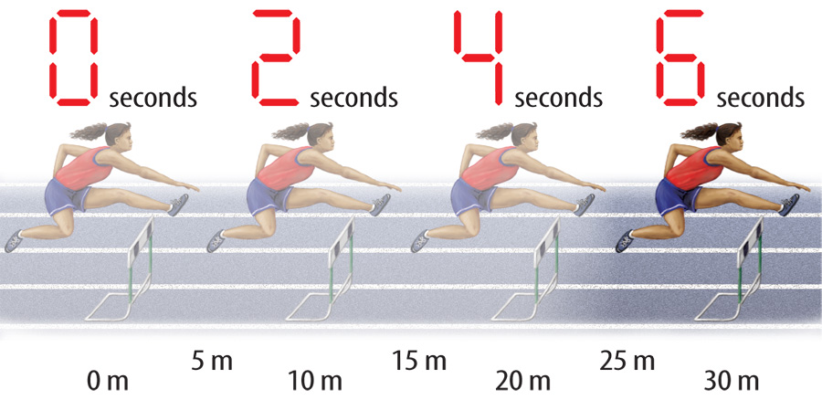
Constant Speed
1.2 Speed, Velocity, and Acceleration
An object moving at constant speed travels the same distance each second.
This hurdler is moving at a constant speed of 5m/second.

Slide 5
Velocity
1.2 Speed, Velocity, and Acceleration
Velocity is the speed and direction of a moving object.

Slide 6
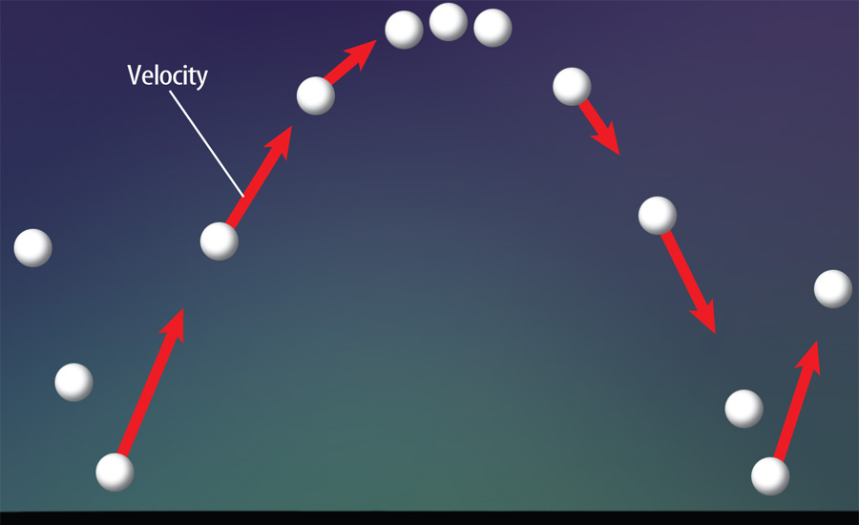
Velocity (cont.)
1.2 Speed, Velocity, and Acceleration
Velocity is a vector because it has both direction and size.
The size of a velocity vector is the speed.

Slide 7
How Fast Can I Go?
In partners, we will go outside and measure our distance and our time using meter sticks and a stopwatch.
BRING A HARD SURFACE TO WRITE ON!
Have even numbers pick up materials and then line up at the door.

Slide 8
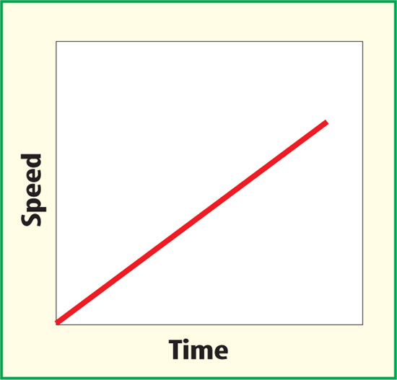
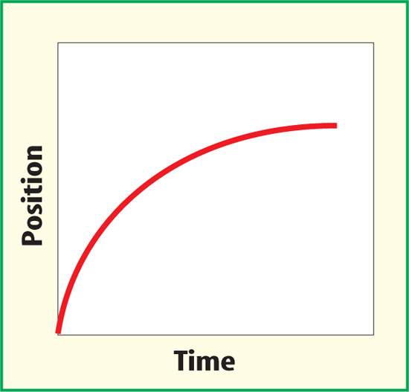
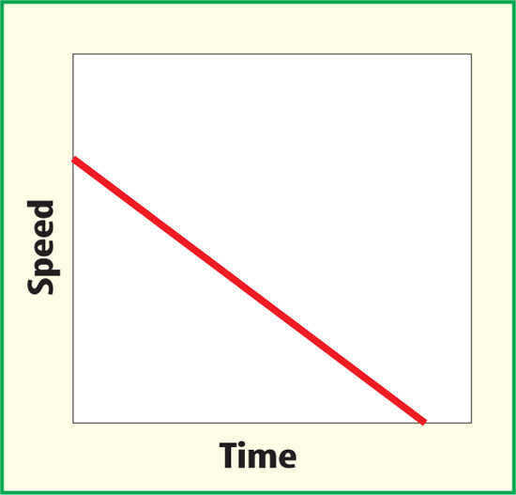

Acceleration
1.2 Speed, Velocity, and Acceleration
Acceleration is the rate at which velocity changes with time.
Acceleration

Slide 9
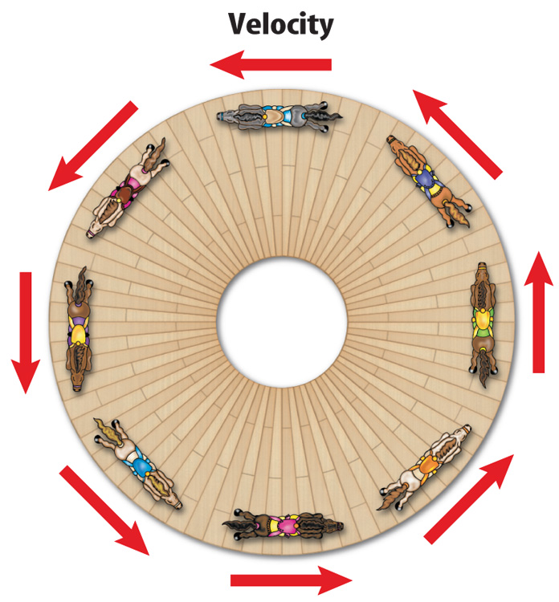
Acceleration (cont.)
1.2 Speed, Velocity, and Acceleration
The horses on the carousel are constantly accelerating and changing direction,
so they are constantly changing velocity
even though their
speed remains
constant.

Slide 10


Lesson 2 Review
1.2 Speed, Velocity, and Acceleration
Acceleration is the rate of change
of ____.
A velocity
B speed
C time
D direction
A
B
C
D

Slide 11
Lesson 2 Review
1.2 Speed, Velocity, and Acceleration
A car stopping at a red light is and example of a(n) ____.
A displacement
B acceleration
C direction
D velocity
A
B
C
D

Slide 12
Lesson 2 Review
1.2 Speed, Velocity, and Acceleration
It takes a runner 42.1 s to run a distance of 150 m. What is the runner’s average speed?
A 0.28 m/s
B 3.56 m/s
C 1.75 m/s
D 6.31 m/s
A
B
C
D

