Slide 1
Continental Drift 10/18/12
*Turn in any late Dragon Genetics sheets to the LATE BIN*
Continental Drift activity
Continental Drift notes
HW: Continental drift summary questions
Do Now [journal]
You have just returned from an exciting adventure to the center of the earth! Please describe in your journal what you experienced as you traveled deep within our planet. Describe what temperatures you would have been exposed to (hot, cold…) Your writing should be as scientific as possible.

Slide 2
Our Earth’s Insides
*WRITE IN PENCIL ONLY!*
Write in your guess of each section’s name
Fill in the table using your understanding of temperature, density, and states of matter.

Slide 3
Continental Drift?

Slide 4
Continental Drift?
Drift - something driven, propelled, urged along or drawn together by a natural power
Definition: merriam-webster.com

Slide 5
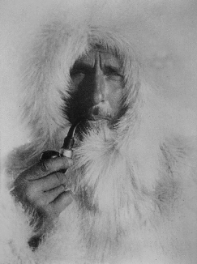
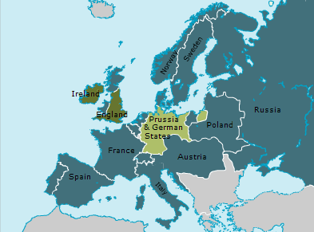
Alfred Wegener
He was born in 1880 in Germany.
Fur coats and a pipe, straight G

Slide 6
Meanwhile around 1880
1879 A yellow-fever epidemic begins in New Orleans.
1880 In less than eighty years, the whaling industry on the Pacific Ocean has collapsed.
1881 On July 2 the President of the United States, John Garfield, is shot by a disgruntled office-seeker. Doctors repeatedly poke their fingers into the bullet hole looking for the bullet, causing an infection. Garfield dies on September 19.

Slide 7
Not the proudest times in science.
So back to this German guy born in Germany in 1880…

Slide 8
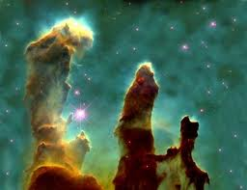

His background
He decided to get his PhD (highest level of education possible) at the University of Berlin in astronomy.

Slide 9

So now he’s a 24 years old, with his PhD in astronomy.
But he had a hobby of studying meteorology, or the study of climate and weather, and also GEOLOGY!
He was a pioneer, or the first person, to use balloons to track air movement.

Slide 10
THINK/PAIR/SHARE
Describe what the geology of Earth looked like from the surface 500 million years ago.
- Where were the continents?
How many oceans were there?
Did we have the same ecosystems?
Talk with your partner about this and come to a conclusion together.

Slide 11
Topic: Continental Drift
Essential Question: What evidence supports the theory of continental drift?

Slide 12
If continents are drifting, where were they in the past? Where are they going in the future?
Look at the current continents on planet Sciencia.
On your Sciencia map write the following:
Name the oceans and continents
Describe the geologic features you see
Give the view you see now a CURRENT DATE
3. Then reconstruct Sciencia 500 mya using scissors and glue.
4. On a separate sheet of notebook paper, SUPPORT YOUR RECONSTRUCTION USING EVIDENCE.

Slide 13
Topic: Continental Drift
Essential Question: What evidence supports the theory of continental drift?
  Alfred Wegener
  In the early 1900’s Alfred Wegener proposed the theory of continental drift
  Continental Drift
  All of the continents were once connected together to form the super continent, Pangaea

Slide 14
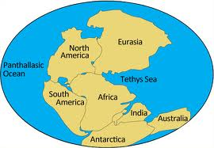
Pangaea! Pan = all gaia = earth

Slide 15
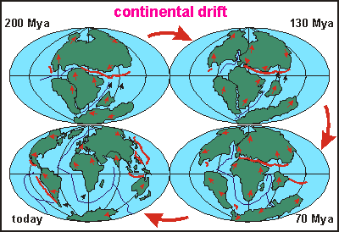
Topic: Continental Drift
Essential Question: What evidence supports the theory of continental drift?
  Continental Drift
  All of the continents have drifted to where they are now
  Earth’s lithosphere (crust) is divided into tectonic plates

Slide 16
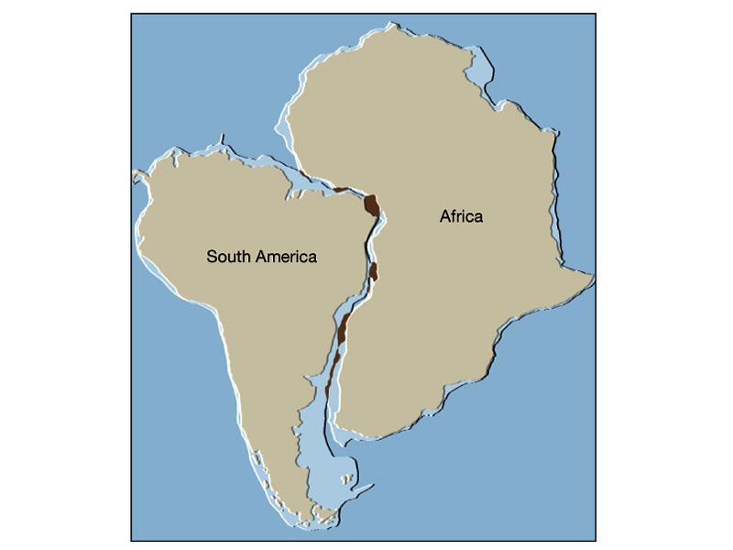
Topic: Continental Drift
Essential Question: What evidence supports the theory of continental drift?
  Evidence
  Africa and South America’s coastlines fit together like a puzzle

Slide 17
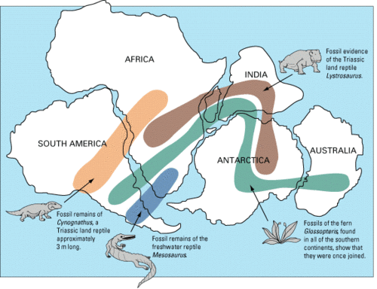
Topic: Continental Drift
Essential Question: What evidence supports the theory of continental drift?
  Evidence
  Fossils and types of rocks on the eastern coast of S. America matched those on the west coast of Africa

Slide 18
A closer look…

Slide 19
Topic: Continental Drift
Essential Question: What evidence supports the theory of continental drift?
  Evidence
  Scientists were able to use new technology to find ocean features such as trenches, mountains on the sea floor, and mid-ocean ridges

Slide 20
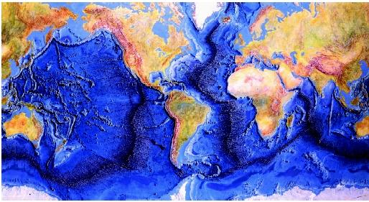

Slide 21
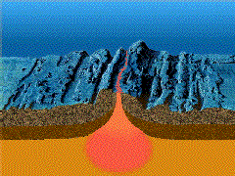
Topic: Continental Drift
Essential Question: What evidence supports the theory of continental drift?
  Harry Hess
  Proposed that at mid-ocean ridges, magma flows up from the mantle and forms new crust on both sides of the ridge
  This new crust makes the ocean floor wider and pushes the continents surrounding it further away from each other

Slide 22
Topic: Continental Drift
Essential Question: What evidence supports the theory of continental drift?
  Alfred Wegener
  In the early 1900’s Alfred Wegener proposed the theory of continental drift
  Continental Drift
  All of the continents were once connected together to form the super continent, Pangaea
What is the theory of continental drift?

Slide 23
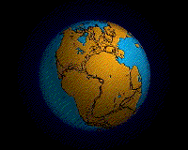
Topic: Continental Drift
Essential Question: What evidence supports the theory of continental drift?
  Continental Drift
  All of the continents have drifted to where they are now
  Earth’s lithosphere (crust) is divided into tectonic plates
What is the lithosphere?

Slide 24
Topic: Continental Drift
Essential Question: What evidence supports the theory of continental drift?
  Evidence
  Africa and South America’s coastlines fit together like a puzzle
What are 3 pieces of evidence that support the theory of continental drift?

Slide 25
Topic: Continental Drift
Essential Question: What evidence supports the theory of continental drift?
  Evidence
  Fossils and types of rocks on the eastern coast of S. America matched those on the west coast of Africa

Slide 26
Topic: Continental Drift
Essential Question: What evidence supports the theory of continental drift?
  Evidence
  Scientists were able to use new technology to find ocean features such as trenches, seamount chains (mountains on the sea floor), and mid-ocean ridges

Slide 27
Topic: Continental Drift
Essential Question: What evidence supports the theory of continental drift?
  Harry Hess
  proposed that at mid-ocean ridges, magma flows up from the mantle and forms new crust on both sides of the ridge
  This new crust makes the ocean floor wider and pushes the continents surrounding it further away from each other

Slide 28
HW:
Look at each question you wrote on your own, and answer each question in a complete sentence.
-What is the theory of continental drift?
-What is the lithosphere?
-What are 3 pieces of evidence that support the theory of continental drift?

Slide 29
Whiteboard Quiz
The person with the ODD number, get one whiteboard for YOURSELF AND YOUR PARTNER. Every person needs a whiteboard.
You have 20 seconds to write an answer, then hold it up!

