Slide 1
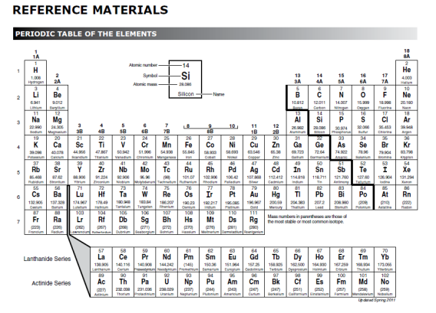
Do Now:
engage
1. Use your periodic table of elements to find the symbols of the following elements:
  Oxygen
  Hydrogen
  Lead
  Sodium
2. How are most of the symbols assigned? What are some exceptions to this rule? Give 3 specific examples.

Slide 2
Chemical Formulas: show the number and kinds of atoms that make up a molecule
Formula
Visual model
O
O
Symbol for oxygen
1 atom of oxygen
O
₂
O
O
Formula for oxygen gas
The subscript tells us that two atoms of oxygen are bonded in this molecule.
“The molecule is composed of 2 oxygen atoms.”

Slide 3
Formula
Visual model
H₂O
H
H
O
Subscript
1 molecule of H₂O
No Subscript,
There is only 1
atom of oxygen in
the molecule
H
H
O

Slide 4
Formula
Visual model
3 H₂O
H
H
H
H
O
O
H
H
Coefficient- Number of molecules
O

Slide 5
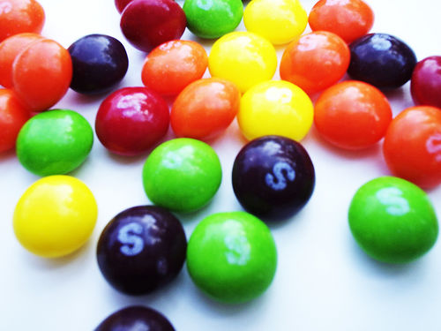
Let’s make some visual models with SKITTLES
explore
You will be able to…
8.5(D) recognize that chemical formulas are used to identify substances and determine the number of atoms of each element in chemical formulas containing subscripts;
8.5(F) recognize whether a chemical equation containing coefficients is balanced or not and how that relates to the law of conservation of mass.
  Key
Red-Chlorine
Orange-Cobalt
Yellow-Oxygen
Green-Hydrogen
Violet- Carbon

Slide 6
With a partner…
Instructions:
Create visual models for the rest of the chemical formulas.
Draw and label the visual models in your journal.
3. For each formula complete the following stems:
The molecule is composed of (#) (kind) atoms…
Chlorine
Cobalt
Oxygen
Hydrogen
Carbon
Color Key

Slide 7
How would you create a visual model for the following?
Co
Chlorine
Cobalt
Oxygen
Hydrogen
Carbon
Color Key

Slide 8
How would you create a visual model for the following?
CO₂
Chlorine
Cobalt
Oxygen
Hydrogen
Carbon
Color Key

Slide 9
How would you create a visual model for the following?
CO
Chlorine
Cobalt
Oxygen
Hydrogen
Carbon
Color Key

Slide 10
How would you create a visual model for the following?
2O
Chlorine
Cobalt
Oxygen
Hydrogen
Carbon
Color Key

Slide 11
How would you create a visual model for the following?
2O₂
Chlorine
Cobalt
Oxygen
Hydrogen
Carbon
Color Key

Slide 12
How would you create a visual model for the following?
H₂O₂
Chlorine
Cobalt
Oxygen
Hydrogen
Carbon
Color Key

Slide 13
How would you create a visual model for the following?
2H₂O₂
Chlorine
Cobalt
Oxygen
Hydrogen
Carbon
Color Key

Slide 14
How would you create a visual model for the following?
2CH4
Chlorine
Cobalt
Oxygen
Hydrogen
Carbon
Color Key

Slide 15
How would you create a visual model for the following?
3CO₂
Chlorine
Cobalt
Oxygen
Hydrogen
Carbon
Color Key

Slide 16
Exit Slip
evaluate
Identify the element found in each of the following compounds. Next, determine the number of atoms in each element.
2Al₂O₃
MgCl₂
3NaOH
Ca(OH)2
Write the formula for the following:
5.
O
Ca
O
O
C

Slide 17
Do Now:
engage
List the evidence for a chemical reaction:

Slide 18
Do Now:
engage
List the evidence for a chemical reaction:
Production of a gas (bubbling, fizzing or foaming)
A change in temperature or light (an energy change)
Appearance of a precipitate (solid material)
A change in color

Slide 19
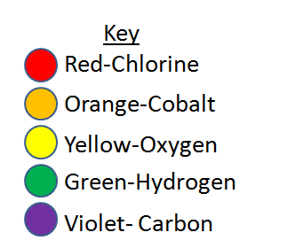
Our combustion reaction again…
explore
Work with your partner to create a visual model of this equation using your skittles.
Draw your visual model in your composition book.
 | Reactants |  | products
Chemical equation | CH₄+2 O₂ | → | CO₂ + 2H₂O
Visual model |  | →
Number of atoms | ______ carbon atoms ______ hydrogen atoms ______ oxygen atoms | → | ______ carbon atoms ______ hydrogen atoms ______ oxygen atoms

Slide 20
 | Reactants |  | products
Chemical equation | CH₄+2 O₂ | → | CO₂ + 2H₂O
Visual model | + | → | +
Number of atoms | 1 carbon atom 4 hydrogen atoms 4 oxygen atoms | → | 1 carbon atom 4 hydrogen atoms 4 oxygen atoms

Slide 21
 | Reactants |  | products
Chemical equation | CH₄+2 O₂ | → | CO₂ + 2H₂O
Visual model | + | → | +
Number of atoms | 1 carbon atom 4 hydrogen atoms 4 oxygen atoms | → | 1 carbon atom 4 hydrogen atoms 4 oxygen atoms

Slide 22
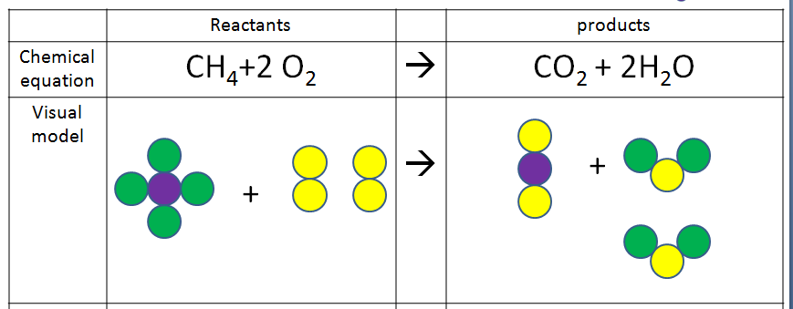



explain
Law of Conservation of Mass
The mass of the reactants is equal to the mass of the products.
Mass is neither created nor destroyed.
reactants
products

Slide 23
explain
A balanced chemical equation:
Follows the law of conservation of mass.
The atoms on the reactant side rearrange to form the products.
reactants
products

Slide 24
Let’s now model another chemical equation with our skittles…
elaborate
 | Reactants |  | products
Chemical equation | C + O₂ | → | CO₂
Visual model | + | →
Word equation |  | To yield
Number of atoms |  | →
1 atom carbon react with 1 molecule oxygen
1 molecule CO₂
1 carbon 2 oxygen
1 carbon 2 oxygen

Slide 25
Is it a balanced equation? How do we know?
elaborate
 | Reactants |  | products
Chemical equation | C + O₂ | → | CO₂
Visual model | + | →
Word equation |  | →
Number of atoms
1 atom carbon + 1 molecule oxygen
1 molecule CO₂
1 carbon 2 oxygen
1 carbon 2 oxygen

Slide 26
More practice…
elaborate
 | Reactants |  | products
Chemical equation | 2C + 2O₂ | → | 3CO₂
Visual model | + | →
Word equation |  | To yield
Number of atoms
2 atoms carbon react with 2 molecule oxygen
3 molecules CO₂
2 carbons 4 oxygen
3 carbons 6 oxygen
Is it balanced?

Slide 27
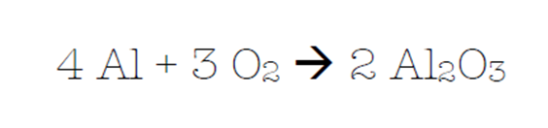
evaluate
Does the above chemical equation follow the law of conservation of mass?
Why?

Slide 28
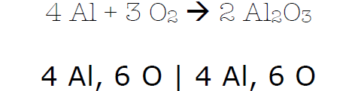
evaluate
Does the above chemical equation follow the law of conservation of mass?
Why?

Slide 29
evaluate
Does the above chemical equation follow the law of conservation of mass?
Why?

Slide 30

evaluate
Does the above chemical equation follow the law of conservation of mass?
Why?

