Slide 2
THINK
Think of a crustal feature you’d like to visit.
Describe THREE of it’s physical characteristics.
How could you describe those physical features to someone deaf?

Slide 3
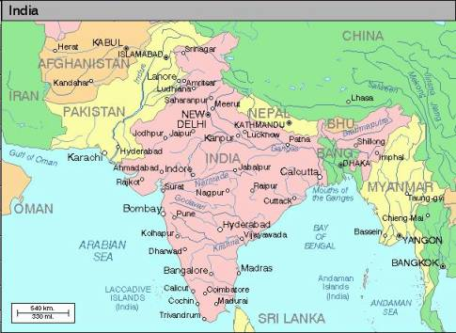
POLITICAL MAP

Slide 4
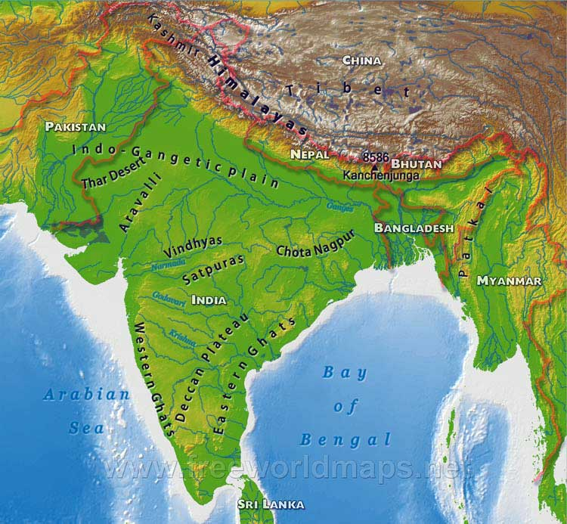
PHYSICAL MAP

Slide 5
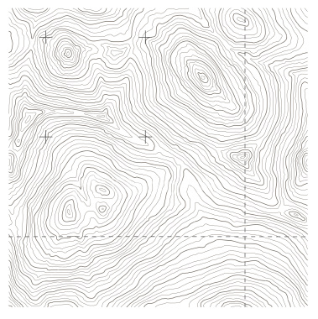
WHAT THE WHAT MAP???

Slide 6
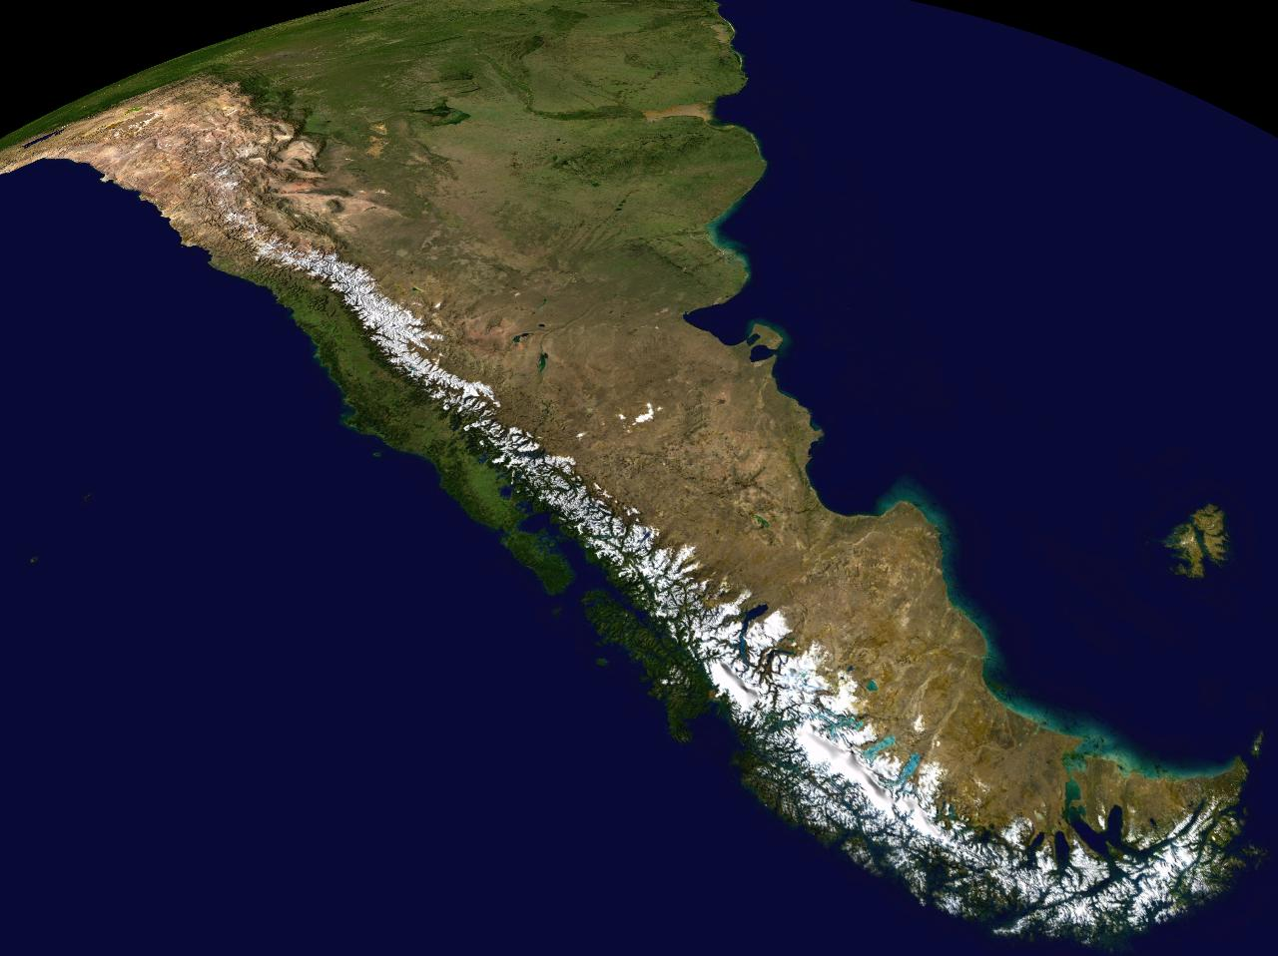

Slide 7
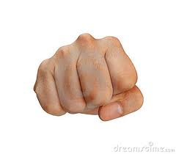
Mt. Knuckles

Slide 8
What else do you want to know about topographic maps?
You can use them to see the bathymetry underwater too, like when you’re fishing in a lake or in the gulf!

Slide 9
Welcome to TOPOGRAPHIC MAPS
A topographic map uses contour lines to show elevation, height above or below sea level. This map uses a satellite view and can also illustrate how weathering changes Earth’s surface.

Slide 10
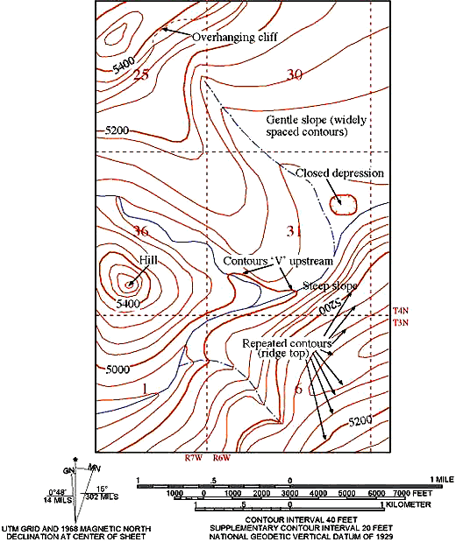
Topographic Maps

Slide 11
What is a Topographic Map?
In contrast to most maps, a topographic map shows the shape of the Earth’s surface by using contour lines.

Slide 12
Contours are imaginary lines that join points of equal elevation above or below sea level.

Slide 13
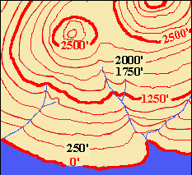
Knowing which way a river flows is often the key to being able to label contours correctly. It helps you find direction.
What happens to the contour lines in this picture when they cross a river?
They bend to form an upside down “V”.

Slide 14
What does the upside down V mean?
The point of the V is facing upstream. So you know the elevation is higher in the direction of the point.

Slide 15
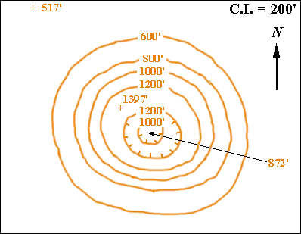
Depression Contours

Slide 16

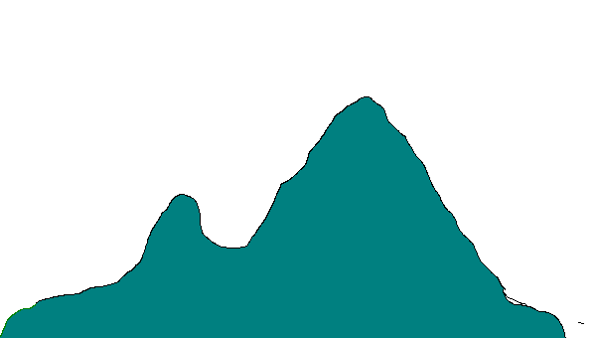

Let’s take a walk up a hill!

Slide 17
We’re now at an elevation of 100 meters.
100m

Slide 18
Let’s keep going!
100m

Slide 19
Now we’re at 200m.
200m
100m

Slide 20
Shall we march on?
200m
100m

Slide 21
We’ve made it to 300m!
300m
200m
100m

Slide 22
On to the peak!
300m
200m
100m

Slide 23
We’re on the peak, but what’s our elevation?
300m
200m
100m

Slide 24
Any ideas?
Let’s add contour lines for every 50 meters and see if that helps.
300m
200m
100m

Slide 25
We know that we are above 350m, but less than 400m.
350m
300m
250m
200m
150m
100m
50m

Slide 26
Let’s head down the hill, it’s getting late!
350m
300m
250m
200m
150m
100m
50m

Slide 27
Now what’s our elevation?
If you said somewhere between 200m and 250m you are right!
350m
300m
250m
200m
150m
100m
50m

Slide 28
Let’s try this again!
350m
300m
250m
200m
150m
100m
50m

Slide 29
What’s our elevation now?
If you said 50m or just under, you’re right!
350m
300m
250m
200m
150m
100m
50m

Slide 30
Let’s now look at the same hill, but the way we might see it from an airplane!

Slide 31
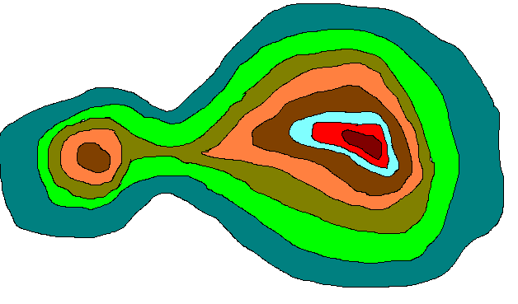
Each color change represents a 50 meter increase.

Slide 32
Now, let’s try the same hike! Our elevation is 0 meters.

Slide 33
Now what is our elevation?

Slide 34
If you said more than 150 meters, but less than 200 meters your right!

Slide 35
Let’s go a little higher.

Slide 36
Think you know our elevation now?
More than 300meters
But less than 350meters

Slide 37
If we were standing on the peak, what would be our elevation?
More than 350 meters, less than 400 meters

Slide 38
Let’s head down hill.

Slide 39
Know our elevation?

Slide 40
More than 100 meters,
less than 150 meters

Slide 41
I think you got it!

Slide 42
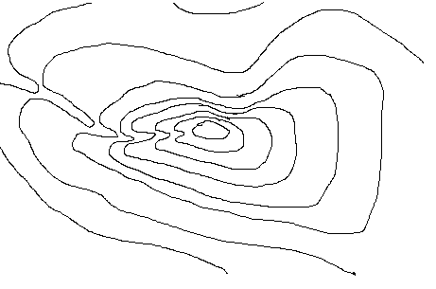
Let’s see what you know.
E
C
D
B
1200m
F
A
1000m
400m
800m
600m

Slide 43
Quiz Time
Grab a piece of paper and write your answers to the following questions.
Ready?

Slide 44
1. Could the elevation at the peak (B) be 1410 meters?
E
C
D
B
1200m
F
A
1000m
400m
800m
600m

Slide 45
2. What is the elevation at
(E)?
E
C
D
B
1200m
F
A
1000m
400m
800m
600m

Slide 46
3.What is the elevation difference between (A) and (B)?
E
C
D
B
1200m
F
A
1000m
400m
800m
600m

Slide 47
4. Could the elevation at (F) be 417 meters?
E
C
D
B
1200m
F
A
1000m
400m
800m
600m

Slide 48
5. If you walked a straight line from (D) to (C) would you walk over a ridge or down a valley?
E
C
D
B
1200m
F
A
1000m
400m
800m
600m

Slide 49
6.Just looking at the map, would it be easier to head down from the peak going East, or going North?
N
E
C
D
B
W
1200m
E
F
A
1000m
400m
800m
600m
S

Slide 50
Answers!
1. No :The elevation must be under 1400 meters, but over 1300 meters.
2. about 400 meters

Slide 51
Answers!
3. (A) is probably close to the 750 meter line, (B) is above 1300 meters. The difference between the two would probably be 650 to 700 meters.

Slide 52
Answers!
4. No: It must be more than 700 meters and less than 800 meters.
5. Down a valley: If the contour lines point up the slope it’s a valley, if they point down the slope it’s a ridge.

Slide 53
Answers!
6. East: When contour lines are close together that means there is a steep slope, the further apart the lines, the more gentile the slope and therefore an easier walk! Go east!

Slide 54
Drawing Contour Lines
Let’s Practice!

Slide 55
Contour Interval __________

Slide 56
Demo for drawing contour lines on map

Slide 57
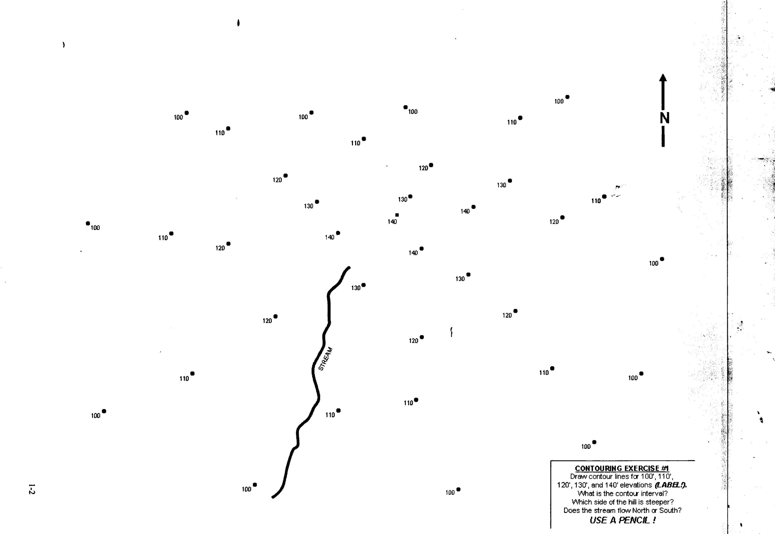
Contour Activity #1

Slide 58
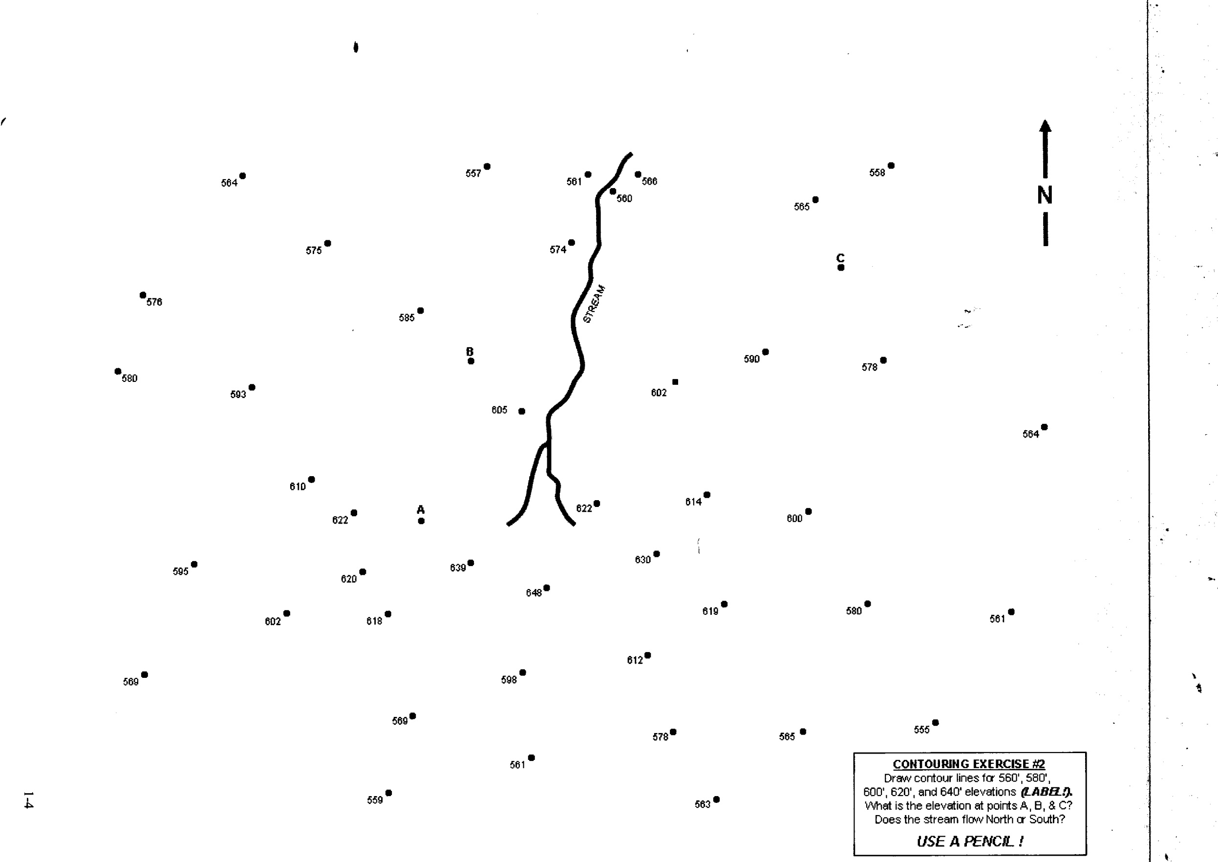
Contour Activity #2

