Slide 1
Ecosystem Characteristics 08/31/12
*Place papers to turn in on top of your green ID*
Clubs are today starting at 2:40 PM!
DO NOW [journal]
If the latex gloves are all out but you need to finish an experiment quickly, what do you do?
What is the difference between an ecosystem and a community?

Slide 2
COMMUNITY population WATER
HERDS Parasite
SHARP TEETH PREDATOR
OXYGEN ESCAPE COMMENSALISM
SUNLIGHT COMPETITION photosynthesis
Notes:
Ask which words are new to them
Which word(s) are the most important for a plant?
Which word(s) are the most important for a rabbit? Shark?

Slide 3
[JOURNAL]
EVEN #: Describe at least four ecosystems. Include temperature, precipitation, biotic life, and location on the planet.
ODD #: Write a precise definition of an ecosystem. When you are finished, help the even #’s with their ecosystems.
Notes:
2 minutes to write, 1 minute to raise hand and share example. Ask if others have the same, anything to add to shared ecosystems.

Slide 4
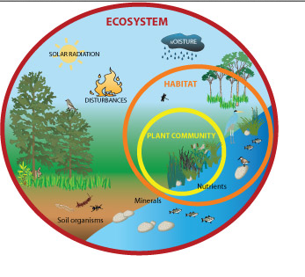
What defines an ecosystem? [binder]
An ecosystem is a biological community of interacting organisms and their physical environment.
What is the physical environment? How do we define this?
In what ways to organisms interact with it?
Is it necessary for them to interact?
Notes:
Class notes go on a sheet of paper in their binder. These should include definitions, diagrams, or important information written by the teacher. These will go in order along with worksheets put in binder. For the questions, write along with the students on the DOC CAM and have them follow along by writing in binder.

Slide 5
Physical environment
Made up of two things:
The BIOTIC – living things
The ABIOTIC – non-living things
Put these words in your WORD WEB.
Notes:
Tell students to now look at their word web. Tell them this is a graphic organizer – a way of writing ideas down on paper to help them learn. They can place biotic and abiotic in any oval, as long as ECOSYSTEM is written in the middle oval for Topic.

Slide 6
ABIOTIC OR BIOTIC?
Harvard – oxygen, soil, bacteria
Columbia – clouds, humidity, pine tree
Texas – fungus, rain, carbon dioxide
Yale – granite, sun ray, water
Berkeley – dew, reindeer, leaves
Princeton – sand, cactus, heat
Notes:
1-2 minutes for each group to decide on biotic/abiotic classification. Some words, like leaves, may incite discussion. If a leaf is on a tree, it is biotic, if it is on the ground, is it abiotic?

Slide 7
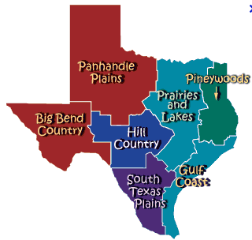
Our physical environment
1. What are FOUR biotic features of Austin?
2. What are FOUR
abiotic features of
Austin?
Notes:
Ask a student to state where Austin is. These are discussion questions (don’t need to be written down). Use random call and have students give one example of each and write it down on the DOC CAM. Words should include organisms we see and things like temperature, rainfall, terrain, sunlight, weather, etc. Discuss differences across Texas, possibly how political borders can be influenced by abiotic features, like the Rio Grande and the border of Texas, and ask if organisms other than humans obey political borders.

Slide 8
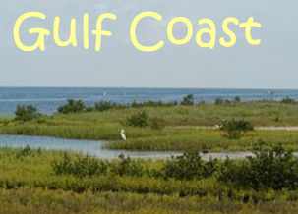
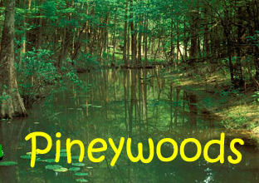
Scientific thought [binder]
Do the combination of biotic and abiotic features make a region UNIQUE from other regions?
VS
Notes:
On the binder note sheet, have them make a Venn Diagram of the Gulf Coast and Pineywoods. Explain these are both ecosystems of Texas. They may notice similarities like water, vegetation. You can ask: how is the water different? [fresh vs salty]. Do you think that is important for the life found there? How about how tall the plants are? Are there forests on the beach? Is there sand in the pineywoods?
Ask two other examples:

Slide 9
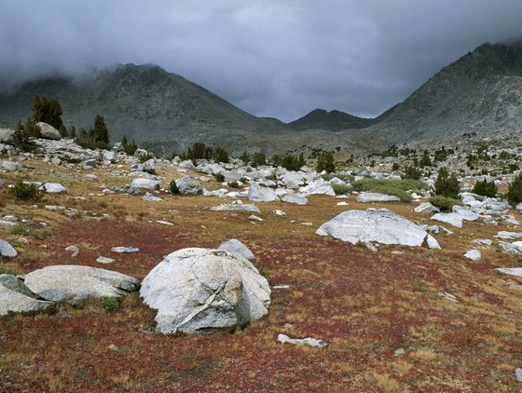
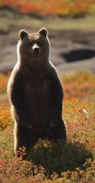
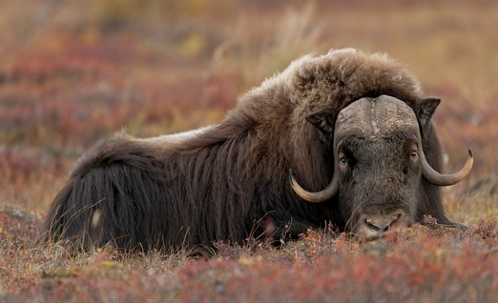
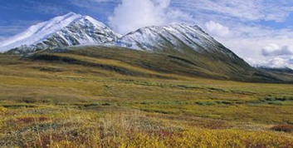
Notes:
Is this in Texas? No, where might it be? Does anyone know what we call this ecosystem? [Tundra]. What does the biotic life look like? What does the abiotic look like?

Slide 10
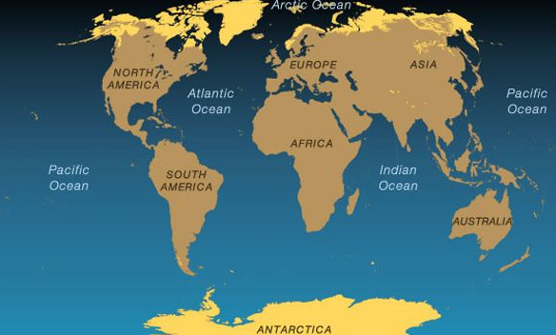
What ecosystem is this? Why is it found in these places?
Notes:
In binders, write down Tundra – high latitudes, gets months of sunlight and months of darkness, low lying vegetation, animals that can live in the cold, snow and ice

Slide 11
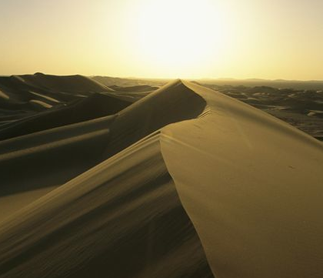
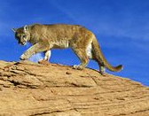
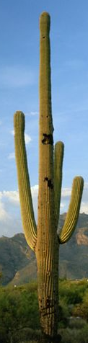
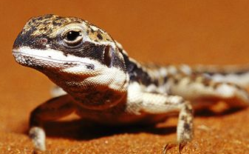
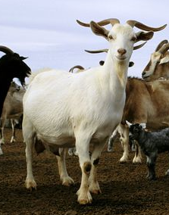
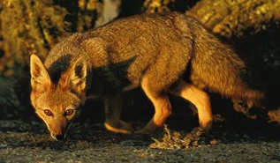
Notes:
Desert ecosystem, ask same kinds of questions about biotic and abiotic features

Slide 12
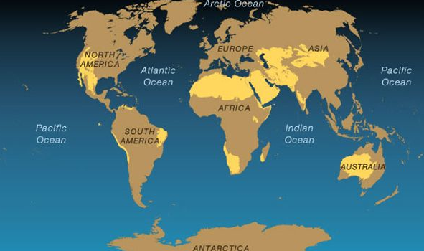
What ecosystem is this? Why is it found in these places?
Notes:
In binders, Desert – latitudes closer to the equator, sandy, hot, dry, low rainfall

Slide 13
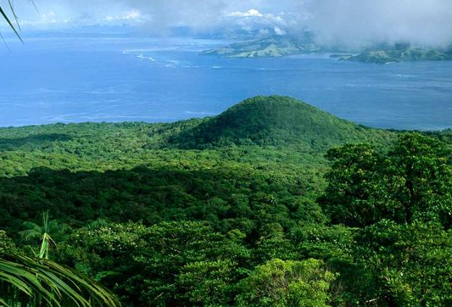
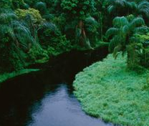
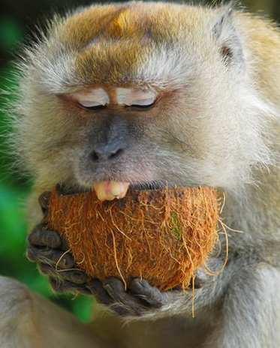
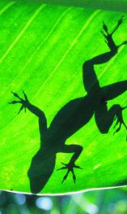
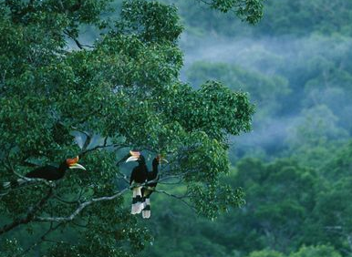
Notes:
Ask same questions about biotic and abiotic features

Slide 14
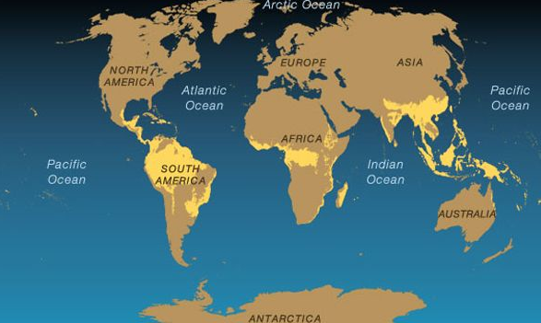
What ecosystem is this? What is this region like?
Notes:
Tropical rainforest – near equator, dense forests, lots of water, rainfall, humid, hot

Slide 15
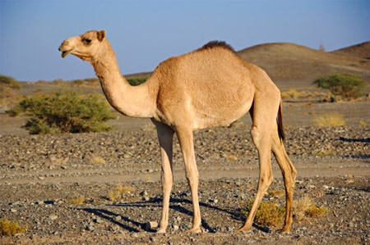
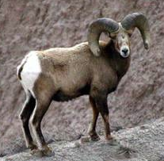
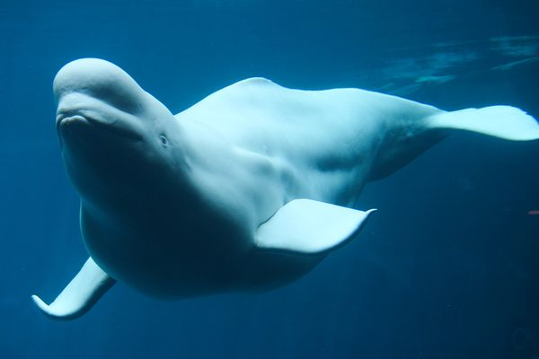
What kinds of abiotic features influenced how these two organisms look?
Notes:
So abiotic features are important for influencing what kinds of organisms live where – like fish in the ocean, tall trees in the rainforest, low grass in the tundra, fur in the arctic – where would these organisms live? What about their bodies has been influenced by their ecosystem? The beluga whale can swim, has blubber for cold temperatures. The mountain goat has hooves for mountain terrain, fur for cold temperatures. The camel has a hump for storing water, hooves for walking in sand.

