Slide 1

University of Texas Libraries
Online Resources for Science Teaching and Learning
9:45-10:40
10:55-11:50

Slide 2
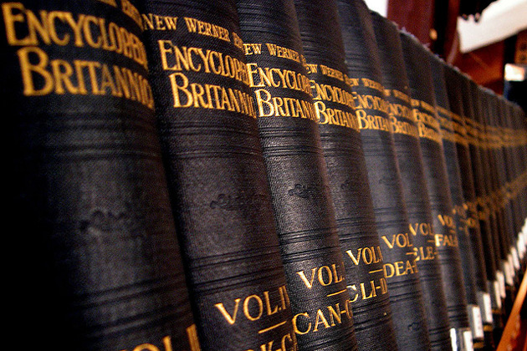
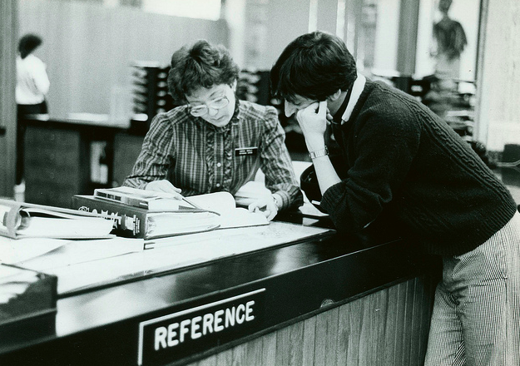
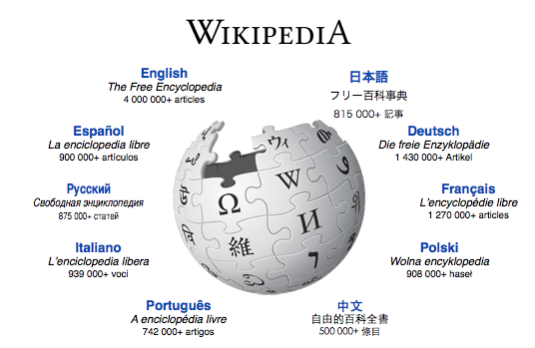
library.duke.edu/uarchives
(Photo used under Creative Commons from flickr user David Morgan-Mar)
What students think they do
What parents think they do
What they actually do
Which is pretty much what teachers and librarians think they do…

Slide 3
What’s a science instruction librarian, anyway?
Teach information literacy skills to students, faculty, staff (See also Standards for the 21st Century Learner, from AASL)
Design information literacy exercises and assignments
Create tutorials
Train lab instructors, teaching assistants, and other instructors
Produce outreach programs using pop culture to highlight science
roxanne.bogucka@austin.utexas.edu | www.lib.utexas.edu/lsl
@UTLSL | facebook.com/UTLSL

Slide 4
Google Tips and Tricks (and Advanced Search!)
Use the symbols!
  inclusion→ death nile +movie
  exclusion→ death nile –mystery -movie
  synonyms→ ~movie occultation venus
  phrase searching→ “occultation of venus”
west nile virus site:cdc.gov
west nile virus intitle:prevalence
inurl:westnilevirus
number ranges→ west nile virus prevalence 1999..2012
define:occultation
related:nsf.gov
Look inside the free books at books.google.com→ occultation astronomy
Look for open access articles at scholar.google.com→
  lunar occultation preprint
  west nile virus open access
See the Google cheat sheet at http://www.googleguide.com/print/adv_op_ref.pdf

Slide 5
TAKE FIVE
Try out some Google searches, using some of the special search features.

Slide 6
FREE Science Resources Online
limited-access content from Science
  news
  ScienceNOW
  Multimedia Center
Nature
  news
  Audio & Video
  Scitable
Scientific American
  blogs at SciAm
  coursepacks
scienceblogs.com
social media—Google+, Twitter, Facebook
  follow science people→ Ex: Bora Zivkovic, blog editor for SciAm; Neil de Grasse Tyson, astrophysicist & science superhero
  search for topics
  search for publications→ Nova, Science, Nature, Scientific American, Discover, Wired…
FREE: Federal Resources for Educational Excellence > Science
Google search→ Ex: teaching science site:nasa.gov | science activities site:nih.gov | educational resources site:epa.gov |
TED talks

Slide 7
Kinds of Science Literature
Grey Literature
Unpublished research articles, working papers, company reports, etc.
Primary Literature
Journal articles (research), dissertations & theses, datasets, conference papers & posters
Secondary Literature
Journal articles (review), term papers, scientific books
Tertiary Literature
Newspaper articles, magazine articles, textbooks, lab manuals, popular science books, popular science web sites, reference books, encyclopedias

Slide 8
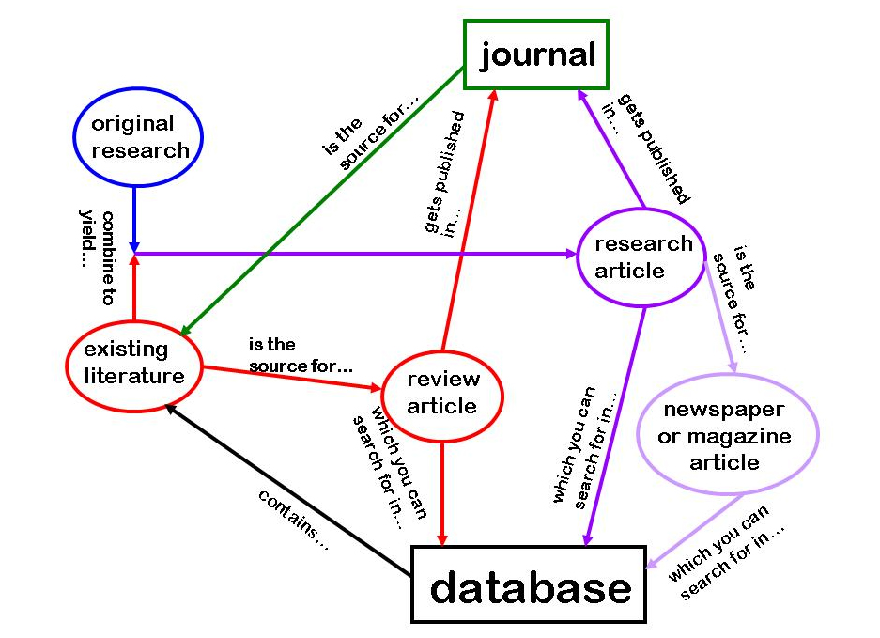
Building Blocks of Scientific Literature
peer review

Slide 9
Evaluation—Some Guidelines for Peer-Reviewed Science Resources
Can you tell why the research was done, and what the researchers’ question was?
Are the research methods described? Are the methods appropriate for the question posed? Are the methods replicable?
Is data given or at least summarized? Could the methods used yield the type of data reported?
Do the data support the study conclusions? Do the conclusions address the research question? Are study problems or limitations reported?

Slide 10
Evaluation—Some Guidelines for Popular Science Resources
Who wrote this information?
What are the author’s qualifications?
Is the information linked to peer-reviewed or otherwise authoritative resources?
Why was this information written?
Who is the intended audience for this information?
How current is this information?
Do other authoritative sources confirm this information?
Does the information contain signs of bias?

Slide 11
TAKE FIVE
Find at least two different levels of science information about kinesio-tape.

Slide 12
Evaluating Science Resources—Some References
Evaluating Web Sites
Evaluating Books, Journals, Magazines, Newspapers
How to Read a Scientific Paper (Purdue)
Reading, Evaluating, and Citing Information (Univ. of California, Irvine)
Evaluating a Paper (Univ. of Arizona)
Stemwedel, J. (2011). Evaluating scientific claims (or, do we have to take the scientist’s word for it?). Scientific American blog: Doing Good Science. Accessed August 16, 2012.
du Prel, J-B, B. Röhrig, and M. Blettner. (2009). Critical appraisal of scientific articles. Deutsches Arzteblatt International 106(7): 100–105.
Hutchings, C. and H.E. Ojalvo. (2010). Studying the Studies: Evaluating Science and Health News Reports. NY Times, Jan. 13, 2010. Accessed August 16, 2012.

Slide 13
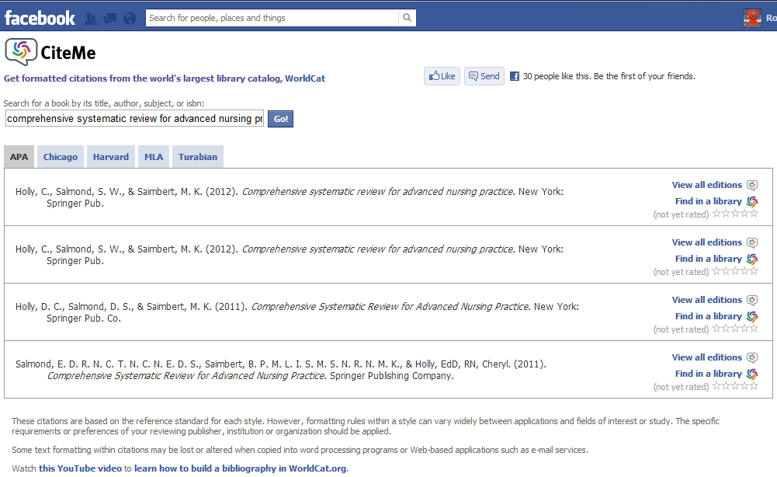
CiteMe is a Facebook app that creates formatted citations in APA, Chicago, Harvard, MLA, or Turabian style for books and other items found in WorldCat.

Slide 14
Myfav.es is a homepage-customization site that has a directory of productivity tools.
TAKE FIVE
The UT Libraries has a collection of productivity tools.
Test drive a couple of productivity tools.

Slide 15
Addendum
The online live-response polling tool I used at the beginning is called PollEverywhere.com and under the FREE plan, you can have up to 40 responses per poll. Polls can be open-answer or multiple choice.
For those who hoped that I would cover online resources and databases available through AISD, I can only direct you to your campus librarians and to https://sites.google.com/a/austinisd.org/aisdlibraries/libresources . But I’m sure you’ve been there, done that…
Scirus is a nice index for every discipline. It’s a FREE science-specific search engine that includes journal sources, scholarly and authoritative science information on the Internet, preprint servers for several scientific disciplines, and technical reports from NASA. For most articles, you get a citation and abstract.
I can recommend further resources available to you and your students via Austin Public Library. http://library.austintexas.gov/databases/Science%20and%20Technology. It requires an APL card to login. Sadly, you can’t apply online at this time. Further info here: http://library.austintexas.gov/basic-page/youth-library-card
The UT Libraries DOES allow visitors limited access its online resources. Please see http://www.lib.utexas.edu/visitors/visitor_eid.html for details.
For the physical sciences, the closest analog to an index like PubMed is ADS, the Astrophysics Data System. It covers physics as well as astronomy.
I know some of you expected more coverage of productivity tools. After you’ve had a chance to test-drive the ones from this presentation, if you still have questions, feel free to contact me.
I saw a few responses from folks who’d hoped for content on teaching strategies and engagement methods. I’m afraid that’s not my area. In fact, y’all could teach me so much…
Thanks for attending, and for your great questions!—RB

Slide 16


