Slide 1
Human Interactions 10/08/12
DO NOW [journal]
How do fertilizers on land affect ocean communities?
Who in this class would you ask to open a lid that was on too tight?
How can you reduce your water use?
*Turn in your Runoff Reading by placing it on your Green ID*
New routines
Review test
Runoff reading
Human interaction notes

Slide 2
Bathroom/Water Passes
You must have your bathroom/water passes stamped by me.
If you have both (2) of your bathroom/water passes UNSTAMPED at the end of the 6 weeks, it will be 1 point added to your FINAL GRADE.
I now have a bathroom timer, and you will have three (3) minutes or you will earn yourself a lunch detention.

Slide 3
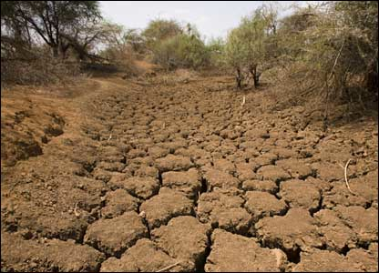
OUR CHANGING WORLD
Short-term environmental changes are changes in an environment that occur over a short period of time such as drought, flooding, volcanic eruption, and pollution.

Slide 4
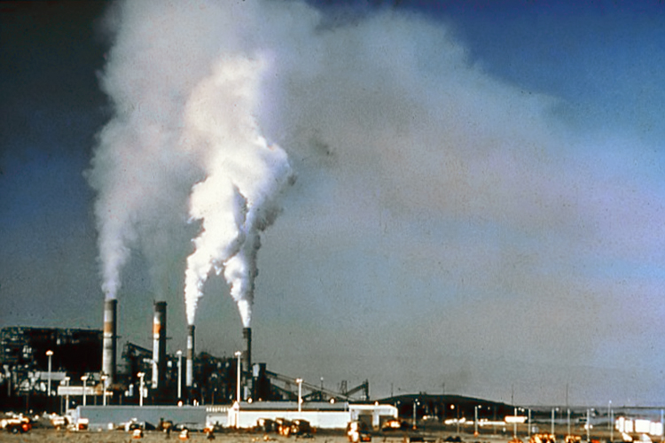

Slide 5
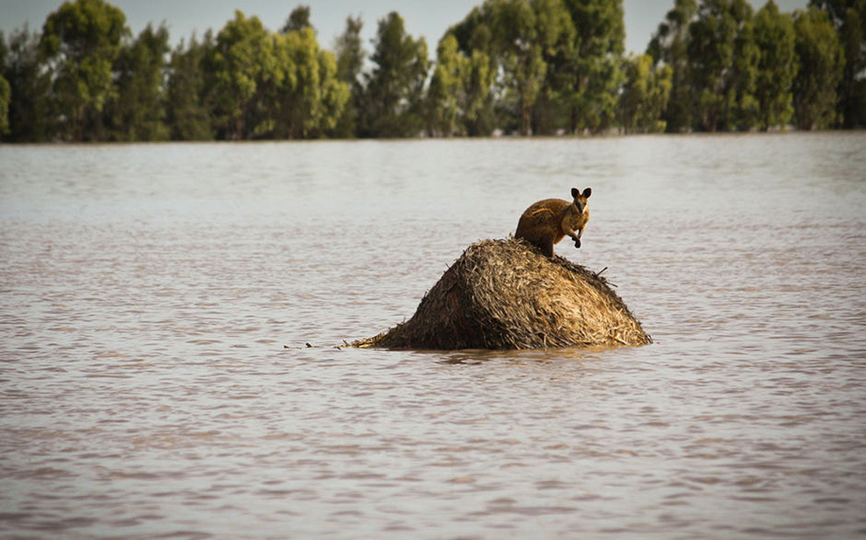

Slide 6
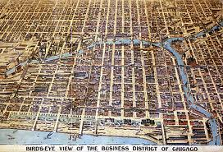
OUR CHANGING WORLD
Long-term environmental changes are changes in an environment that occur over a long period of time such as deforestation, global warming, and urbanization.

Slide 7
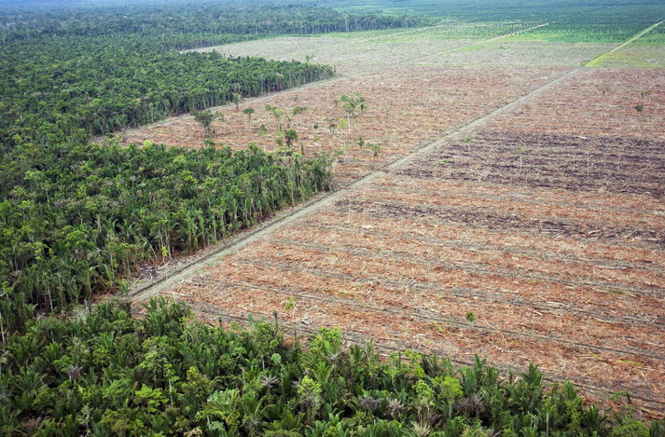

Slide 8
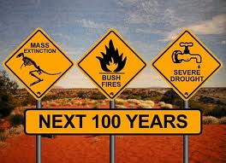

Slide 9
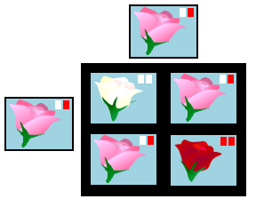
OUR CHANGING WORLD
Short and long-term environmental changes affect organisms and traits in their future offspring.
Punnett
square

Slide 10
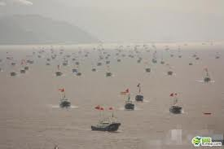
HUMANS AND ECOSYSTEMS
Humans depend on ocean systems in numerous ways such as for food and disposal of waste.

Slide 11
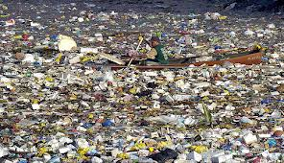
HUMANS AND ECOSYSTEMS
Human activity modifies ocean systems in numerous ways such as depleting marine populations and pollution.
A man boats through the GREAT PLASTIC ISLAND

Slide 12
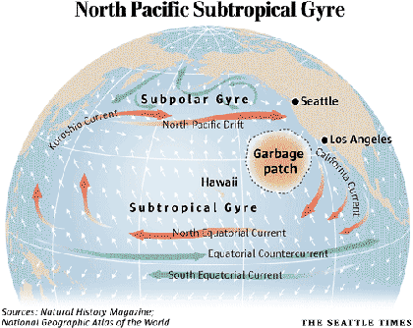
The GREAT PLASTIC ISLAND is a terrible, heartbreaking truth about pollution

Slide 13
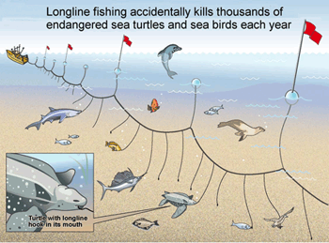
HUMANS AND ECOSYSTEMS
Bycatch is the unwanted fish and other marine creatures caught during commercial fishing for a different species.

Slide 14
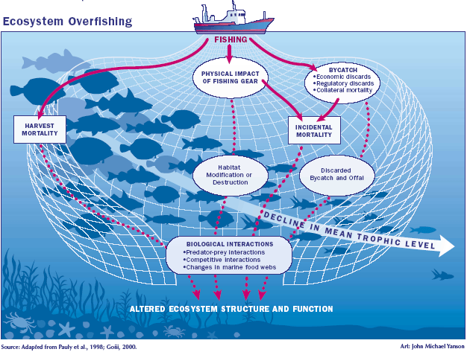

Slide 15
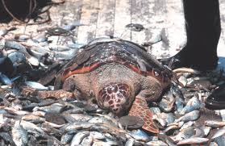
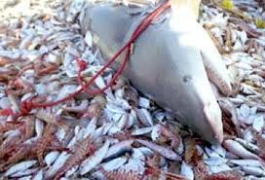
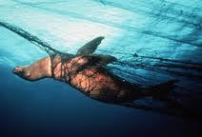
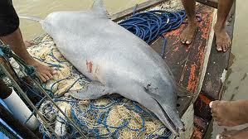

Slide 16
FRESHWATER
Groundwater is water that soaks into the ground and collects in pores and empty spaces underground.
Groundwater diagram

Slide 17
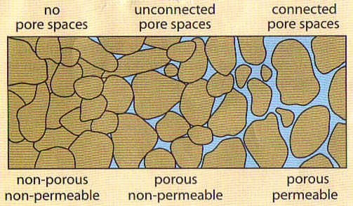
Water soaks into the ground when the rocks are porous and permeable!

Slide 18
Freshwater
A watershed is an area or ridge of land that separates waters flowing to different rivers, basins, or seas.
Human activity can affect groundwater and surface water in a watershed, such as non-point pollution, point pollution, and wasteful use.
Write down three ways to save water.

