Slide 1
Lunar cycle and tides 12/12
*Please have your Reason for the Season reading on your GREEN ID*
Binder check
Moon phase review
Tides
Do Now [journal]
1. What is the role of the Sun in the occurrence of the lunar cycle?
2. What are the eight moon phases of the lunar cycle?
3. What do the terms waxing and waning mean and how do we tell them apart?

Slide 2
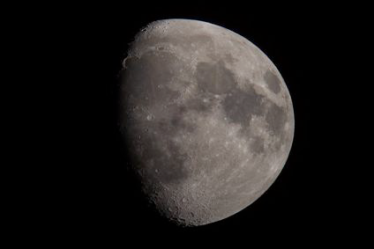

Slide 3
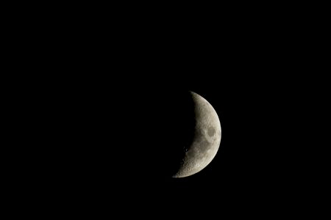

Slide 4
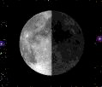
What is the name of the phase of the Moon in the picture?
A 1st quarter moon
B gibbous
C half moon
D last quarter moon

Slide 5
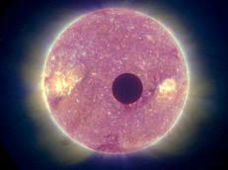

Slide 6
1 What causes the appearance of the Moon to change?
A The amount of light striking the Moon
B The distance between the Moon and the Sun
C The relative position of the Moon, Earth, and Sun
D The mass of the Moon shrinks and grows.

Slide 7
TIDES
Concept 1
Concept 2
Concept 3
The Moon orbits Earth, and Earth orbits the Sun.
As the Earth rotates on its axis, the Moon and Sun exert a gravitational pull on Earth.
The Moon’s gravity pulls on Earth’s surface water, causing the water to rise and fall. The Sun’s gravity also pulls on the Earth’s surface water, causing a second, smaller, tidal effect. This creates a predictable schedule of high tides and low tides that coincide with the lunar cycle.

Slide 8
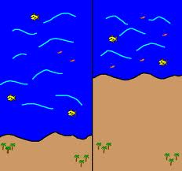
TIDES
Concept 4
High Low
The tides are most noticeable in large bodies of water, such as oceans, seas and large lakes.
High tide is the greatest length inland a body of water reaches.
Low tide is the lowest point on land a body of water recedes to.

Slide 9
When the Sun and Moon are in alignment, as during a new or full Moon, the tide range is greatest. This is called a spring tide and is characterized by higher and lower tides.
When the Sun and Moon are at right angles, as during a first quarter or last quarter Moon, the tidal range is lower. This is called a neap tide and is characterized by high and low tides that are different by only a few inches.
Concept 5

