Slide 1
Genetics/Punnett Squares 10/15/12
*Take out your DRAGON GENETICS questions*
Dragon building
Groundwater quiz
Genetic review
Punnett Squares
Do Now [journal]
What are two ways that humans interact with estuaries?
What’s your partners favorite scary movie?
What is the effect of drilling a well on groundwater resources?

Slide 2
Punnett Squares [journal]
THINK: write your answer to “why are punnett squares useful?”
PAIR: write down what your partner thought.
SHARE: as a class we will compile why punnett squares are useful.

Slide 3
Topic: Punnett Squares
Essential Question: How are Punnett Squares useful?
  Punnett Squares
  Are used to predict the outcome of breeding or mating using genes and their alleles
  Backcross
  If you know the outcome, you can find out the parent

Slide 4
T = Tropism t = no tropism
Tropism: the movement of an organism towards a stimulus
Ex: a plant (producer) needs SUNLIGHT in order to get it’s energy
So how will it experience TROPISM?

Slide 5
Punnett Practice
Let’s do a Punnett Square for this trait:
TT male crossed with a Tt female.
T = dominant (tropism)
t = recessive (no tropism)

Slide 6
Topic: Heredity
Essential Question: How are traits passed on from parent to offspring?
  Heredity
  The passage of genetic instructions from one generation to the next generation
  Chromosome
  Carries genetic information from parent to offspring in the form of GENES
  Allele
  Alternate forms of genes

Slide 7
Topic: Heredity
Essential Question: How are traits passed on from parent to offspring?
  Natural selection
  The process where organisms better adapted to their environment tend to survive and produce more offspring.
  Selective breeding
  The process of breeding plants and animals for particular traits.

Slide 8
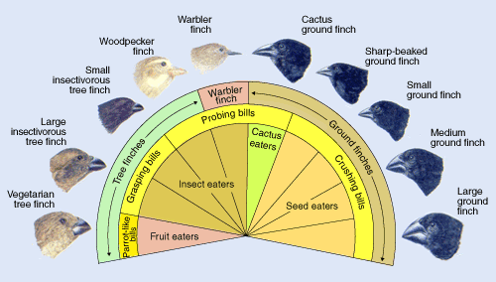
What do the inner, middle, and outer circles represent?

Slide 9
Outer circle = general kind of finch
Middle circle = describes their bill shape
Inner circle = niche, where they get their energy

Slide 10
Natural selection
If there was a FREEZE and the insect population dropped considerably, which finches would survive? Which would die?
The survivors are more likely to produce offspring. The decreased population is more likely to have less offspring.

Slide 11
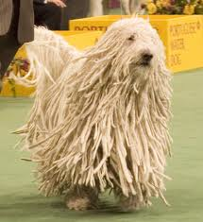
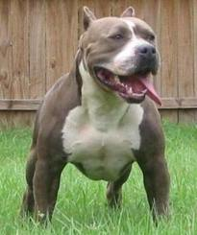
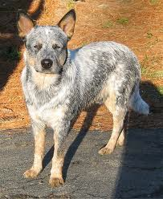
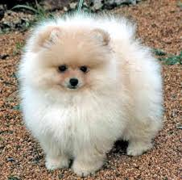
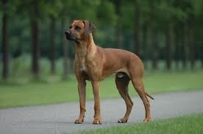
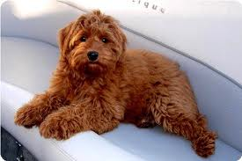
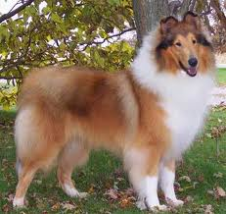
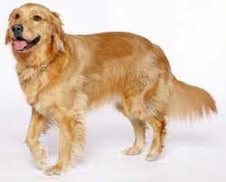
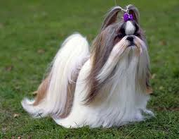

Slide 12
Selective breeding
Dogs are all the same SPECIES meaning they can all mate with each other to produce offspring.
Humans have selectively bred for their traits, not through natural selection.

Slide 13
Topic: Heredity
Essential Question: How are traits passed on from parent to offspring?
  Natural selection
  Ex: Finches on the Galapagos Islands
  Selective breeding
  Ex: Dog breeds

